Slide 1
Demonetization Sentiment Analysis(Twitter)
Team BugZero
Members:
Aarushi Sharma
Prachi Singh
Kumangalam Kirti

Slide 2
Contents
Introduction
Methodology
Result
Conclusion
Future scope

Slide 3
The study analyses impacts on the GDP of India, employement rate, stock market volatility, agriculture sector, and the overall economy. The study shows that the demonetization movement had more short-term impacts than long-term aand it generally failed to achieve its main objective.
Intoduction
The twitter messages provide rich structured information when analysed properly.
So we chose ‘Demonetization in India’ and did a sentiment analysis on the tweets related to it.
In the first part of this project , analysis of the sentiments of each tweet is done.
In the second part we’ve used LSTM to get the sentiment analysis done by dividing the dataset into train and test part
The demonetizatio of ₹500 and ₹1000 banknotes was a step taken by the Government of India on 8 November 2016, ceasing the usage of all ₹500 and ₹1000 banknotes of the Mahatma Gandhi Series as a form of legal tender in India from 9 November 2016.
3

Slide 4
Methodology
Data Collection
Processing
Classification
4

Slide 5
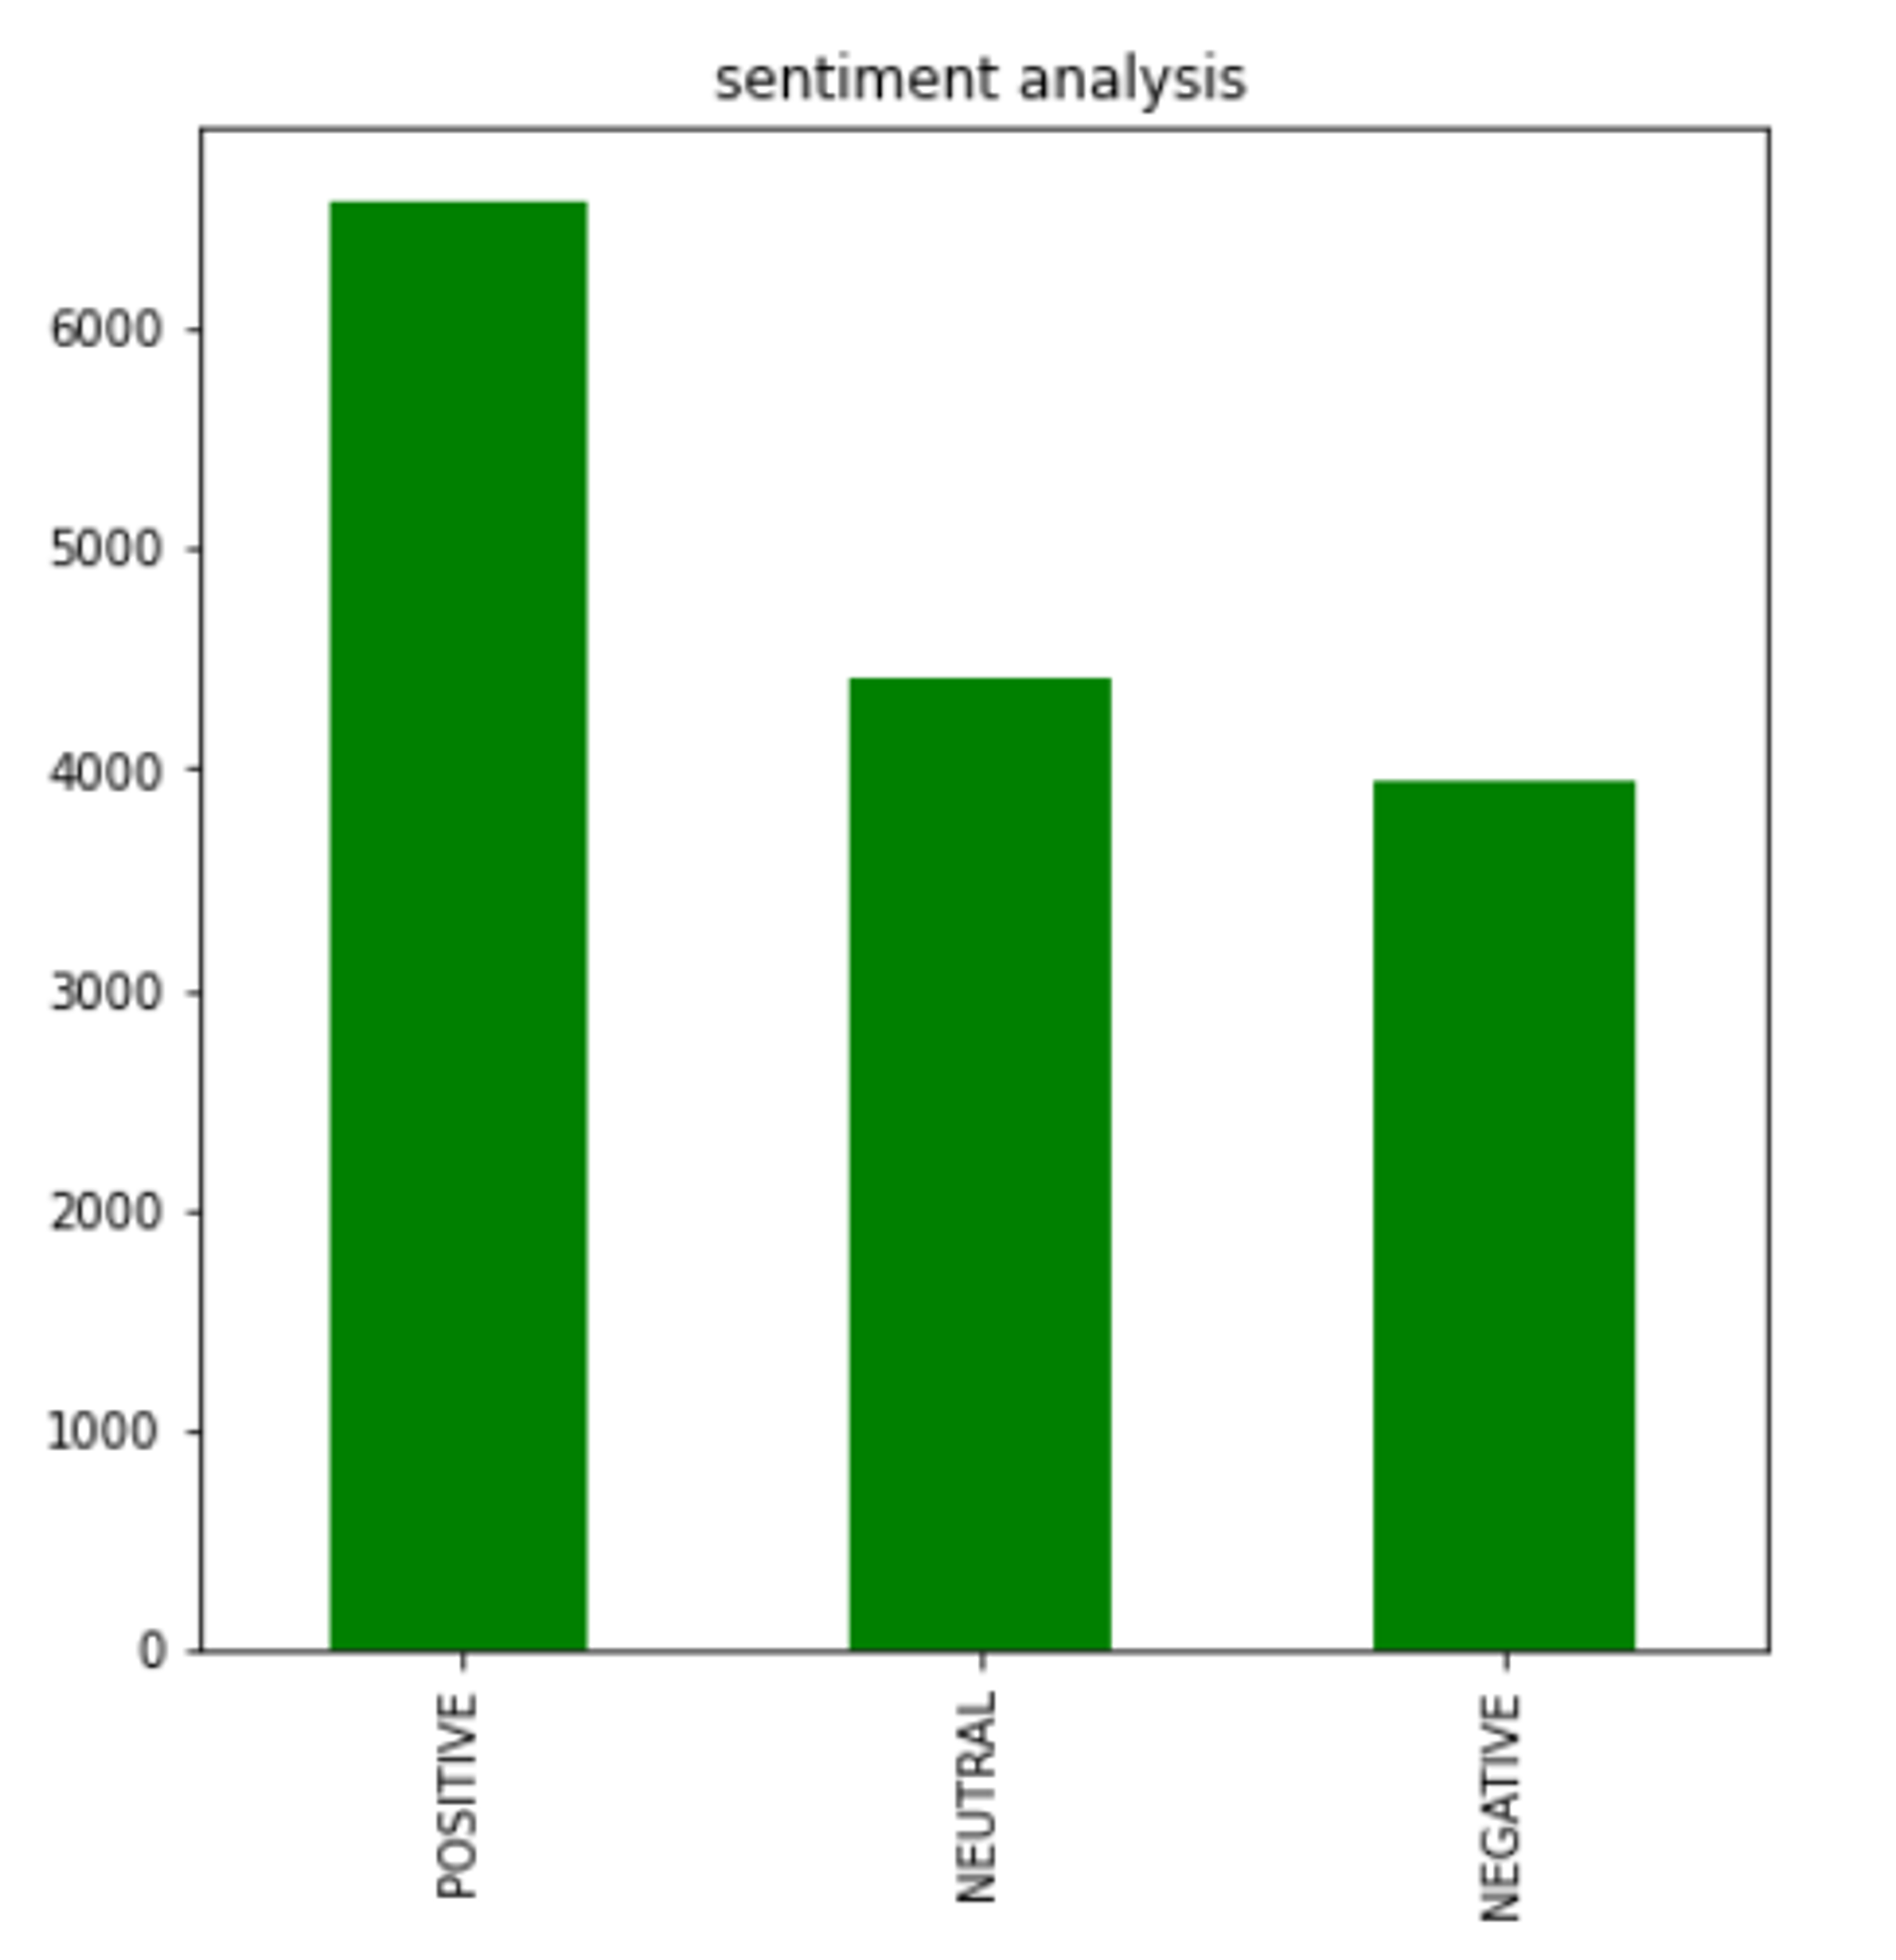
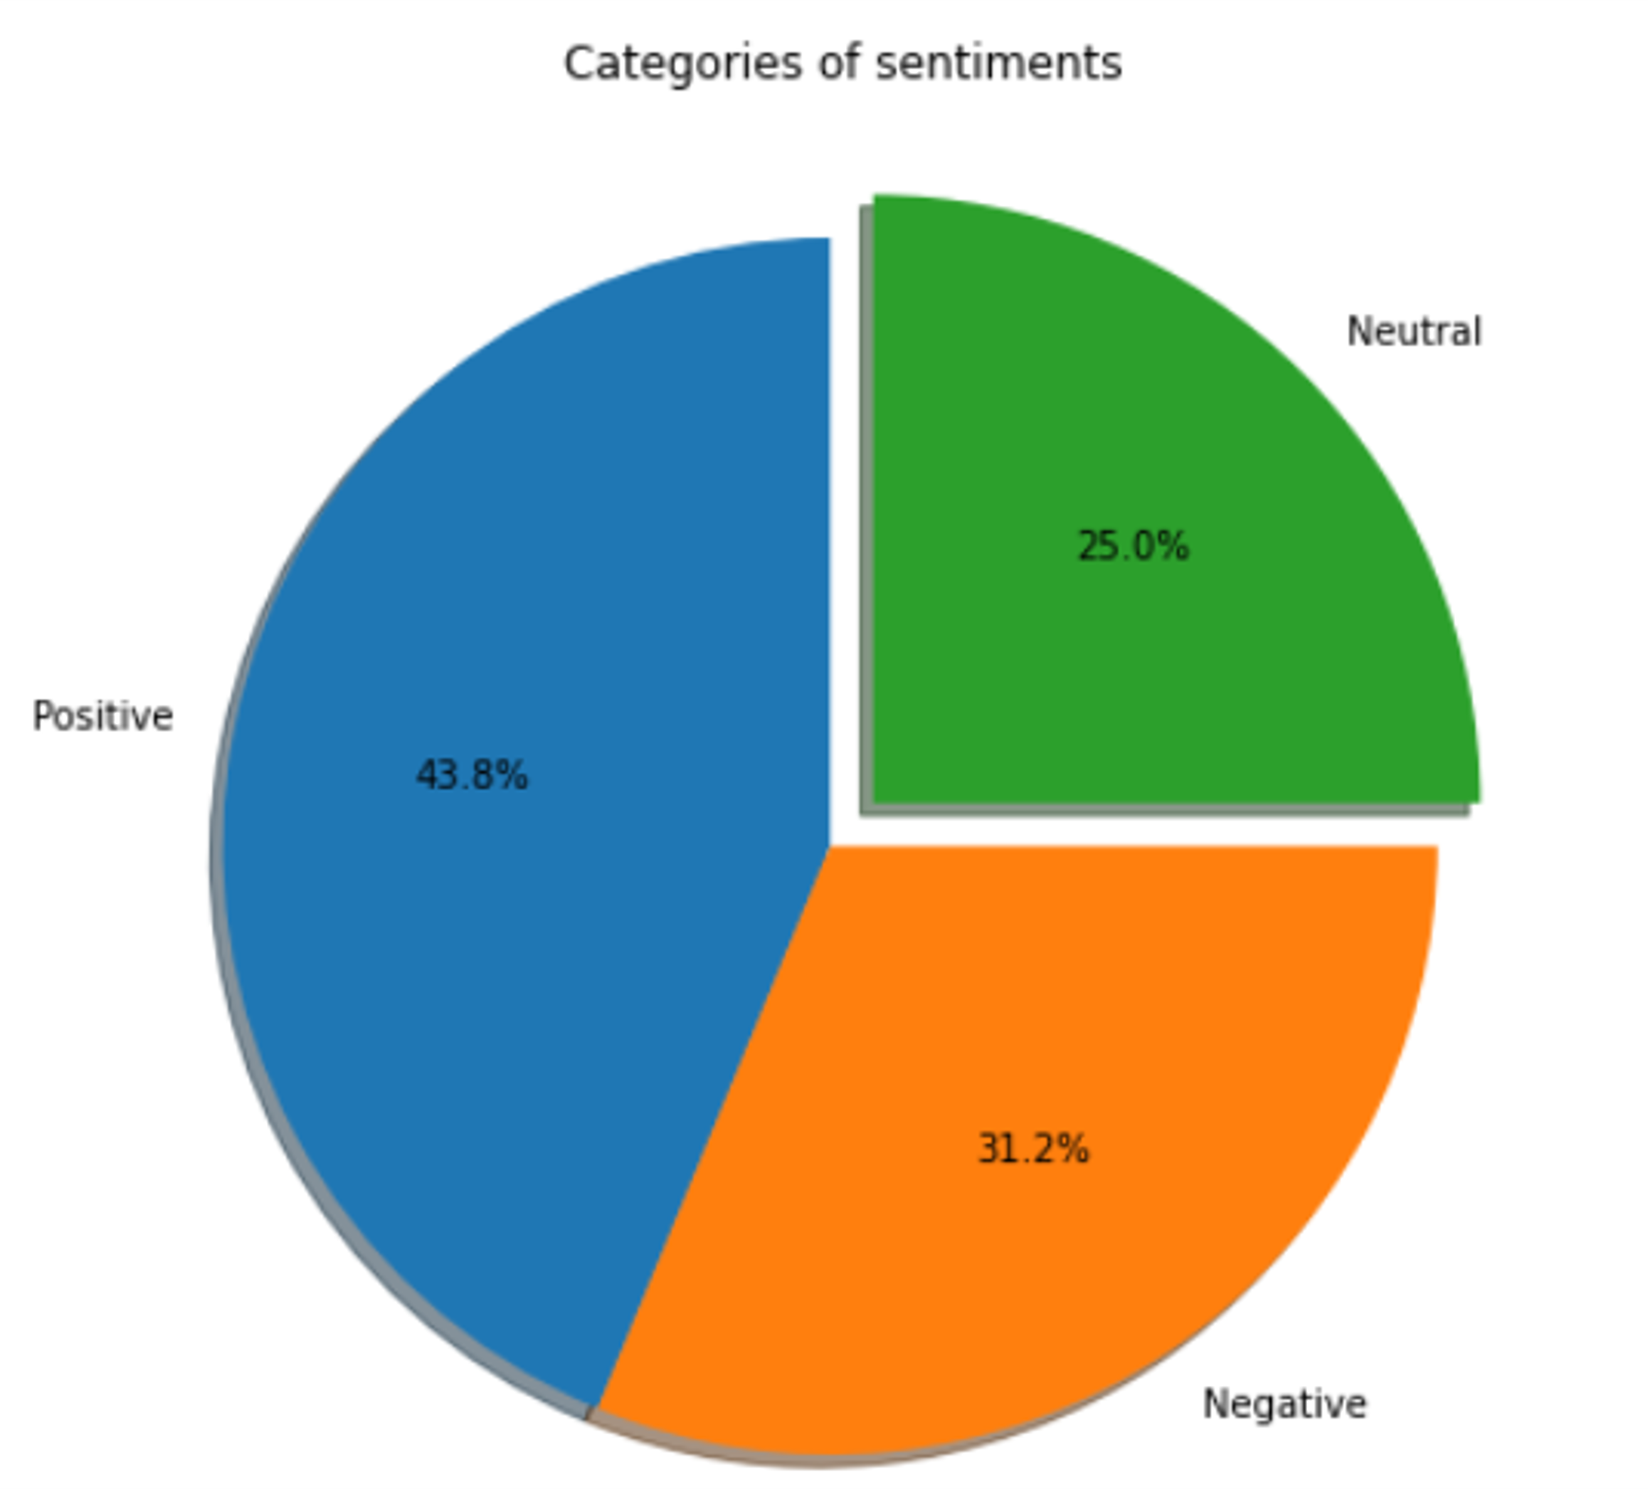
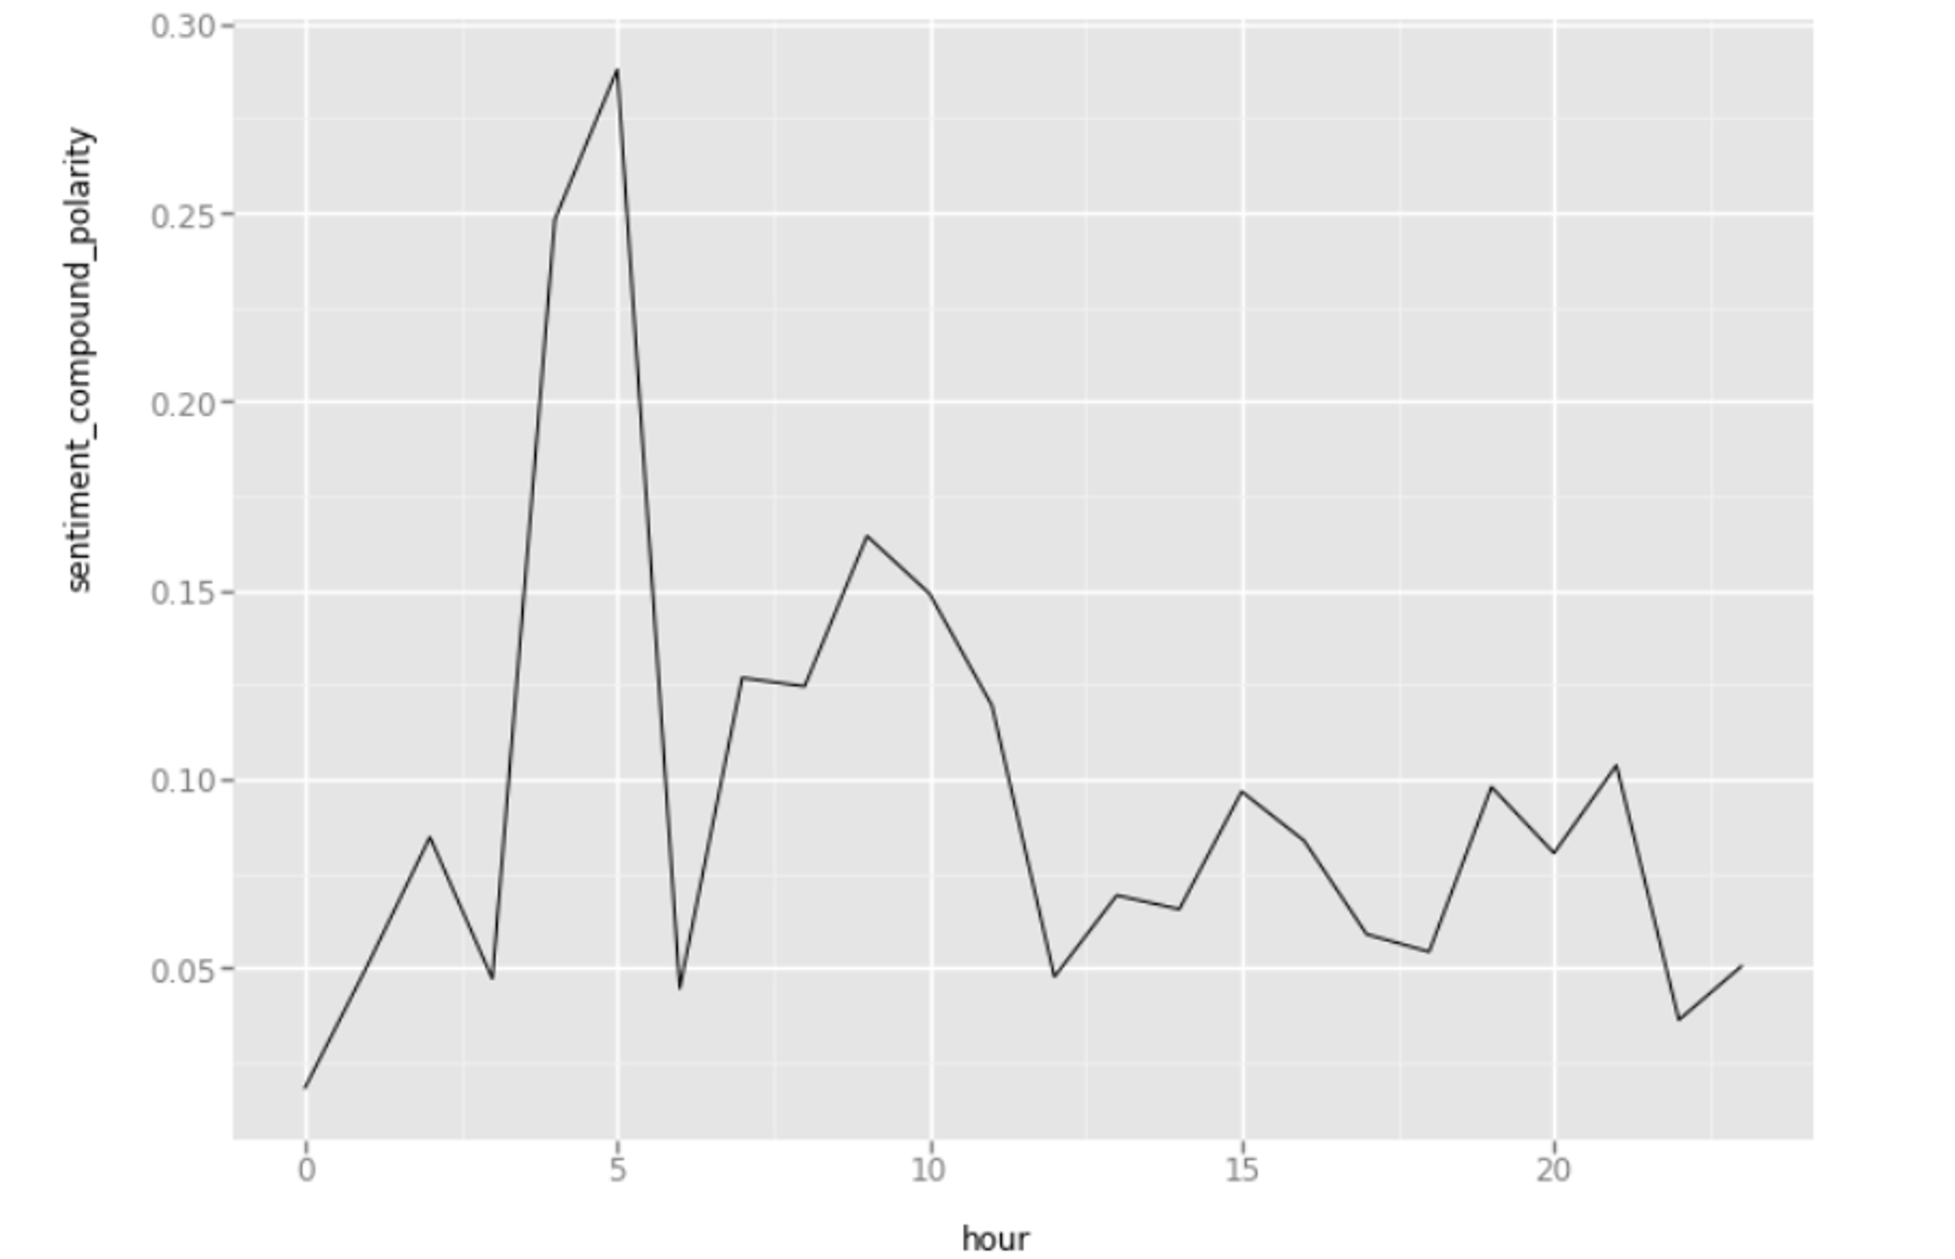
Result
The tweets were analysed and depending upon the reactions they were classified as positive, negative and neutral tweets by the trained model.
These sentiments were then represented graphically like bar charts, pie charts, line graphs.

Slide 6
Conclusion
From the obtained results we its found that a large share of Indian people were happy with this policy. During the initial days the sentiment was more towards the negative side as the common man had to suffer many hardships. Ultimately, as the new banknotes were made available, the overall sentiment of the people became positive. Later study shows that the demonetization movement eventually failed to achieve its main objective.
6

Slide 7
Future Scope
In future we look forward to develop a web application that takes any query from the user and performs the sentiment analysis of the same to give accurate and structured information which can be easily understood by the end user.

Slide 8
Thanks!
8

